Slide 1

Unity 3D Essentials
Animations & Audio
SoftUni Team
Technical trainers
Software University
https://softuni.org

Slide 2

Table of Contents
Animations & Avatars
Animation and Animator
Audio
Useful links

Slide 3
Have a Question?
sli.do
#Unity3D-Basics
Notes:
‹#›

Slide 4

Animations & Avatars

Slide 5
Animations
Types
Sequence of Images
Sequence of transform/component data
What is KeyPoint
Unity Created vs Pre-Unity Created
Sprite animation
Transform/component keypoints sequence
Using avatars

Slide 6
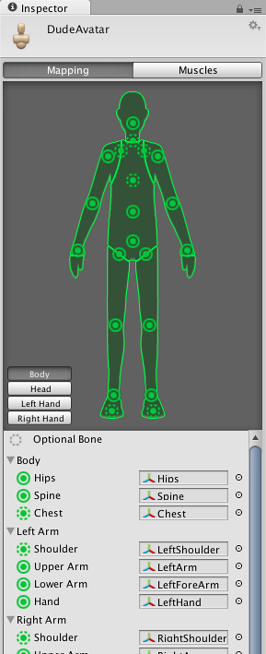
Avatars & Rig
Avatars
Human
Non-human
Rig
Different parts
Muscles/Joint

Slide 7
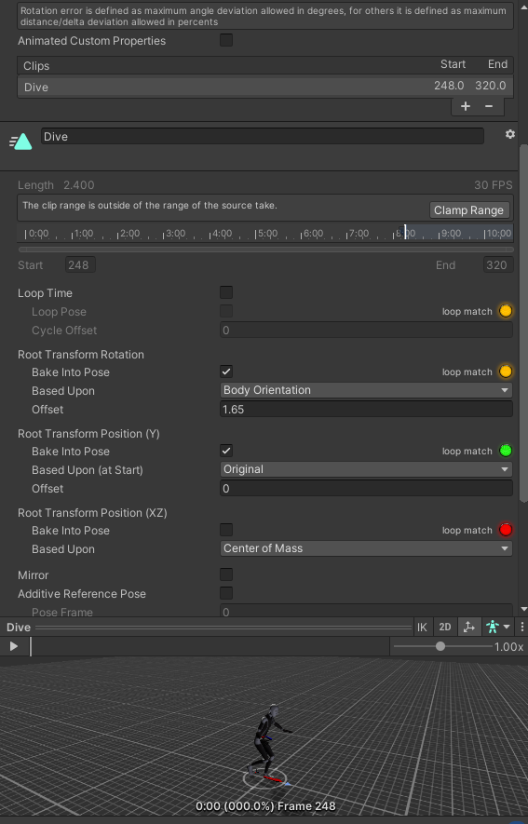
Manage imported animations
Import settings
Clips
Timeline
Transform data

Slide 8
Animations & Animator

Slide 9
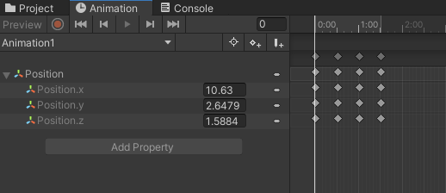
Animation Window
Basic control
Keypoints
Curves
Events
Clip event
Animation event

Slide 10
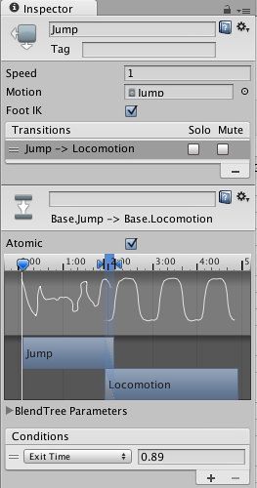
Animator window
States
Transitions
Transition Condition
Blending animations
Condition scripting

Slide 11

Audio

Slide 12
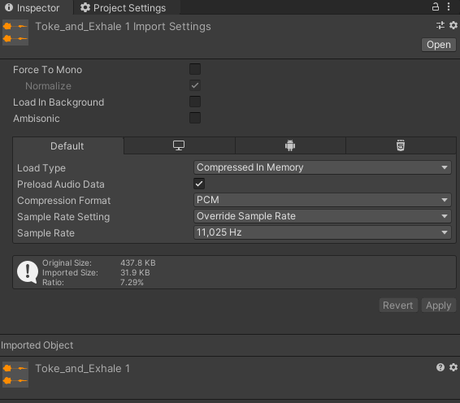
Audio Import
Force To Mono
Load in background
Load Type
Compression
Sample Rate

Slide 13
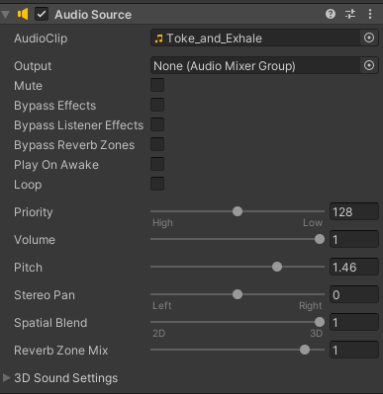
Audio Source
Clip
Audio Mixer
Play on Awake
Loop
Priority
Volume
Pitch
Spatial Blen

Slide 14
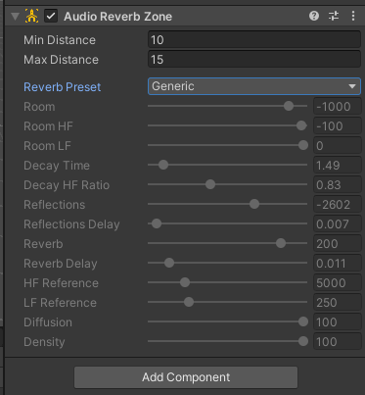
Listener & Reverb zone
Audio Listener
Reverb Zone

Slide 15
Basic scripting
public void PlayAudioClip()
{
bool isTheRightClip = clipToPlay.name == "Toke_and_Exhale";
var audioSource = GetComponent<AudioSource>();
if (isTheRightClip)
{
Debug.Log("PlayAudioClip");
audioSource.clip = clipToPlay;
audioSource.Play();
}
}

Slide 16
Useful Links
http://docs.unity3d.com/Manual/AnimationsImport.html
http://docs.unity3d.com/Manual/ConfiguringtheAvatar.html
http://docs.unity3d.com/Manual/class-AnimationClip.html
http://docs.unity3d.com/Manual/EditingCurves.html
http://docs.unity3d.com/Manual/class-BlendTree.html

Slide 17

Summary
Animations & Avatars
Animation and Animator
Audio
Useful links
Notes:
‹#›

Slide 18
Questions?
Email : dstrashilov@gmail.com
Notes:
‹#›

Slide 19

License
This course (slides, examples, demos, exercises, homework, documents, videos and other assets) is copyrighted content
Unauthorized copy, reproduction or use is illegal
© SoftUni – https://about.softuni.bg
© Software University – https://softuni.bg
Notes:
‹#›

Slide 20
Trainings @ Software University (SoftUni)
Software University – High-Quality Education, Profession and Job for Software Developers
about.softuni.bg, softuni.org
Software University Foundation
softuni.foundation
Software University @ Facebook
facebook.com/SoftwareUniversity
Software University Forums
forum.softuni.bg
Notes:
‹#›

